Slide 1
AI CAREER COMPANION
AI Career Companion Agent for Internship Matching and Interview Preparation
A more relevant search, a stronger application, and a path forward you can see.
Notes:
Internship searching can feel like a maze. This story is about turning that uncertainty into a sequence of practical next steps.

Slide 2

THE FRICTION
Students are asked to navigate too many disconnected tools
Find roles
01
Search across fragmented job boards.
Translate experience
02
Turn coursework into marketable skills.
Tailor the story
03
Rewrite a resume and cover letter for every application.
Prepare alone
04
Practice interviews without knowing what matters most.
Notes:
The problem is not a lack of effort. Students are stitching together separate tools for discovery, positioning, applications, and preparation.

Slide 3
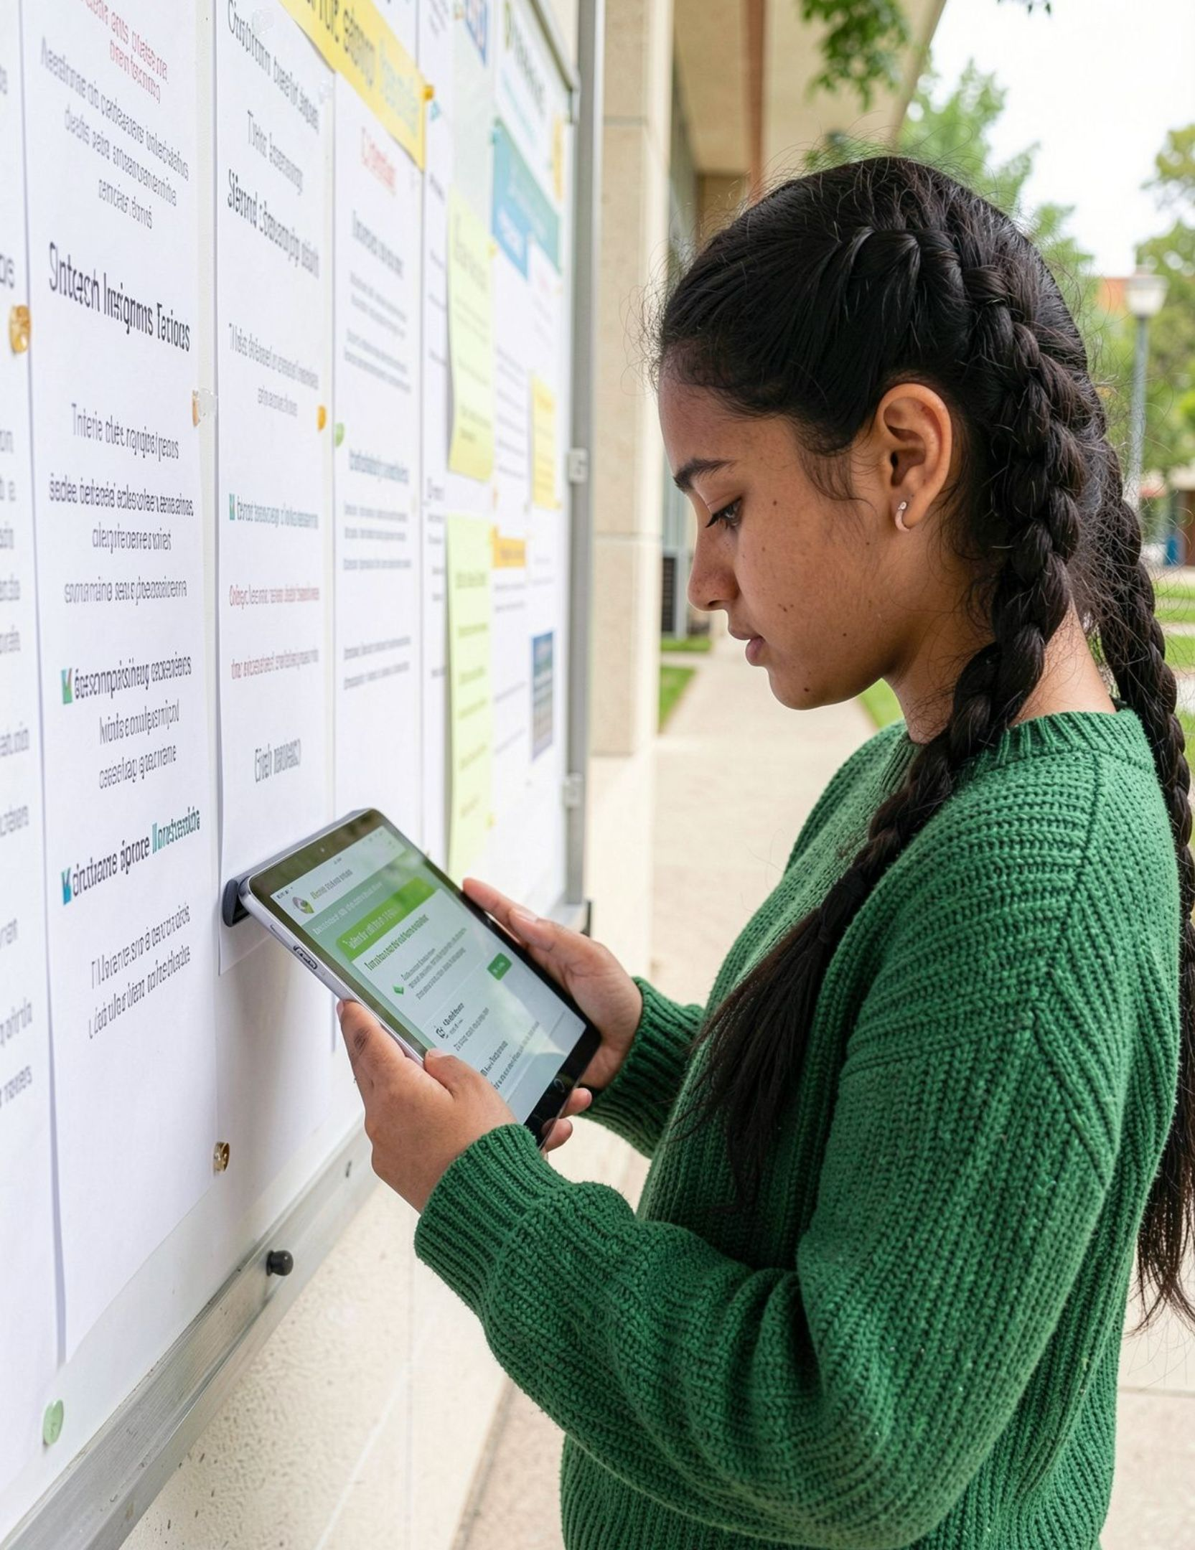
THE SHIFT
Most candidates need guidance, not more job listings
Every recommendation should feel personal: grounded in goals, current skills, target roles, and application history.
Notes:
A useful companion does more than surface options. It helps a candidate understand why an opportunity fits and what to do next.

Slide 4

THE CONNECTED JOURNEY
One AI companion connects the entire journey
The candidate keeps one thread from self-understanding to learning, applying, and improving.
Understand Candidate
Match Internships
Close Skill Gaps
Prepare & Apply
Notes:
The companion follows the candidate across the journey. It starts with context, turns that context into relevant options, then supports the work required to become ready and keep learning.

Slide 5
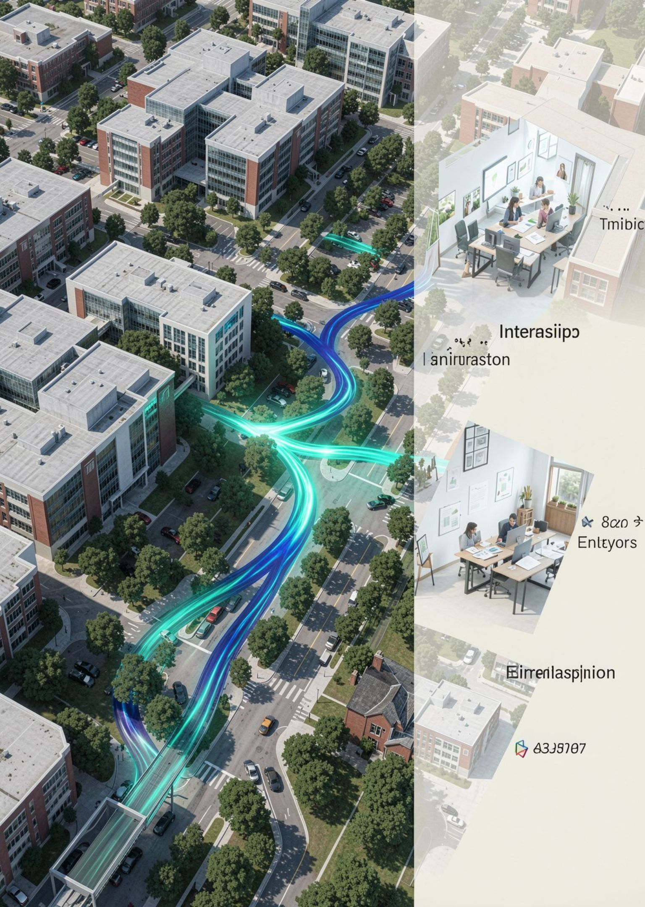

01 · FIND THE RIGHT OPENING
Match candidates to opportunities they can actually grow into
Personalized recommendations
Surface internships that connect to a candidate's direction.
Clear fit signals
Explain why each role fits the person, not just the keyword.
Transferable skills
Show strengths, gaps, and adjacent experience in plain language.
Notes:
Relevance builds momentum. Candidates should be able to see the connection between who they are, what they can do, and where a role could take them.

Slide 6


02 · BUILD READINESS
Turn skill gaps into an actionable learning plan
Replace a vague “I should learn more” with a focused sequence of work.
01
02
03
Identify
Prioritize
Practice
Map the capabilities each target role expects.
Focus first on the gaps that matter most for the next opportunity.
Recommend projects, practice, and resources that create evidence.
Notes:
Readiness is easier to build when it has a shape. The companion turns role expectations into priorities and gives candidates concrete ways to demonstrate progress.

Slide 7




03 · MAKE THE APPLICATION STRONGER
Help candidates show up stronger in every application
Resume feedback
Cover letter support
Application tracking
Shape the evidence around the role, not a generic template.
Connect motivation and experience to the specific opportunity.
Keep deadlines, requirements, and next actions visible.
Notes:
Strong applications are assembled with intention. The companion helps candidates improve the story, meet the requirements, and keep moving before a deadline becomes a crisis.

Slide 8


04 · PRACTICE THE CONVERSATION
Make interview preparation feel like practice, not guesswork
Likely questions
Mock interviews
Useful feedback
Generate role-specific questions.
Practice realistic answers aloud.
Build clarity, evidence, and confidence.
Notes:
Confidence comes from rehearsal with feedback. Candidates can practice the hard parts before the real conversation carries real stakes.

Slide 9
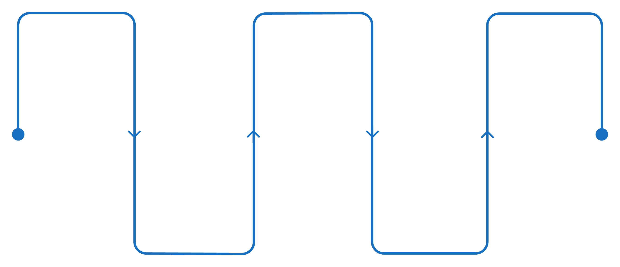
THE VISIBLE MOMENTUM
Progress becomes visible from first search to final offer
One place to track applications, preparation, skill growth, feedback, and next actions.
First search
Skill plan
Final offer
Explore roles and companies
Identify and schedule learning
Negotiate and accept role
Application practice
Shortlist
Select top opportunities
Mock interviews and resumes
Notes:
The value is not only in any single recommendation. It is in making momentum legible, so a candidate knows what has changed and what to do next.

Slide 10
THE OUTCOME
Better preparation creates better internship outcomes
For candidates
For career centers
For employers
More relevant applications and stronger readiness.
Candidates who understand the role and can contribute sooner.
A scalable layer of personalized support.
Notes:
The destination is simple: more relevant choices, better preparation, and clearer momentum for the people starting their careers.

